Slide 1
CLAfICLe: Cross Lingual Adaptation for In-Context Learning
Behind the scenes
Giulio Starace

Slide 2


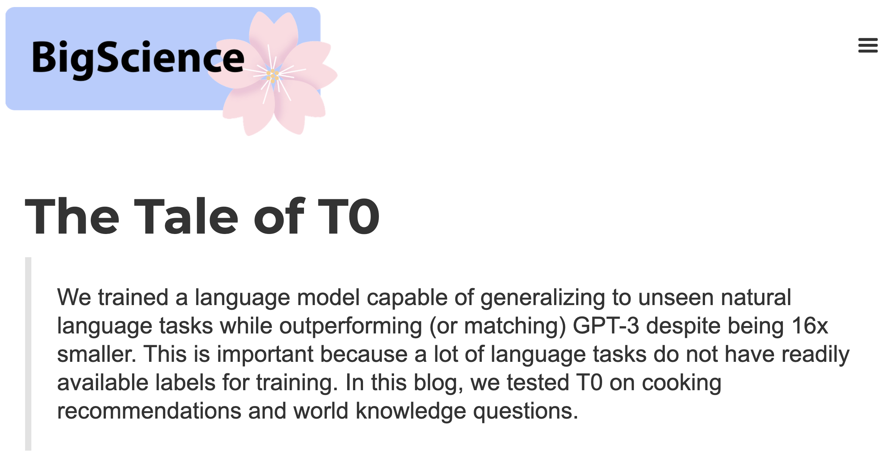



Context

Slide 3
Goal
Adapt T0 to work with Dutch and/or French inputs and outputs.

Slide 4
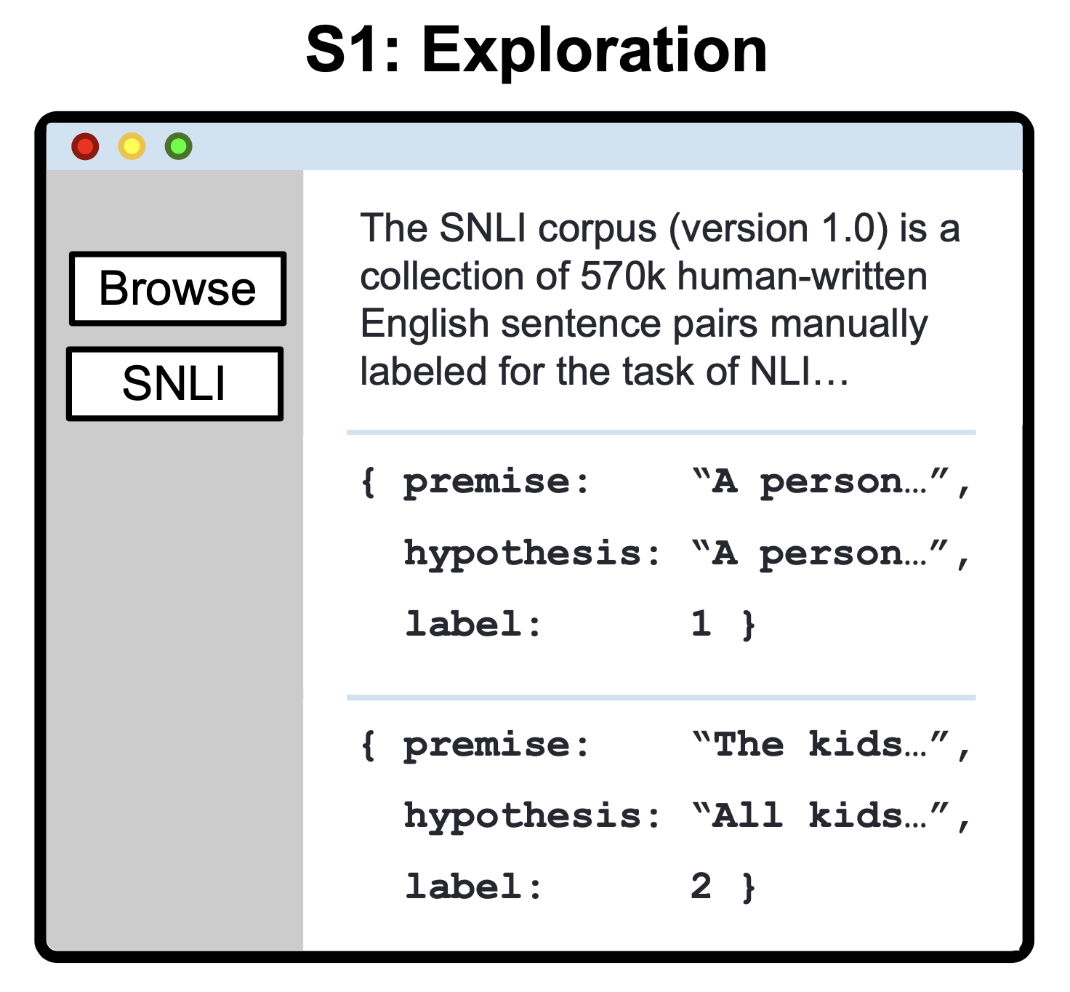
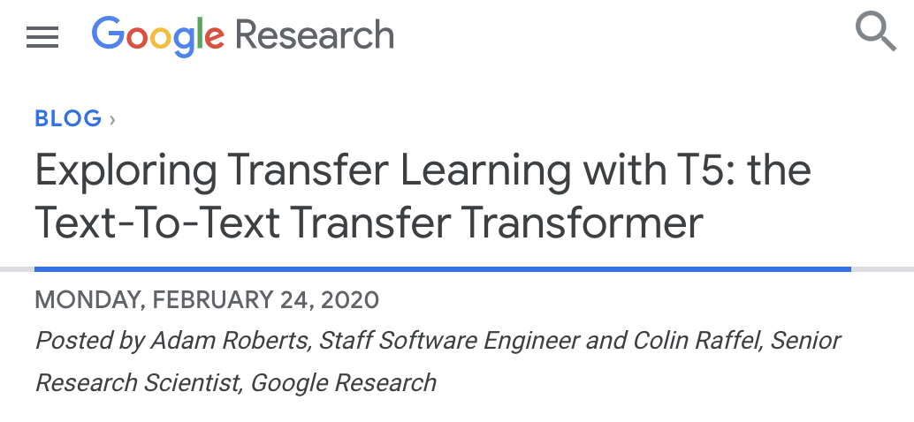
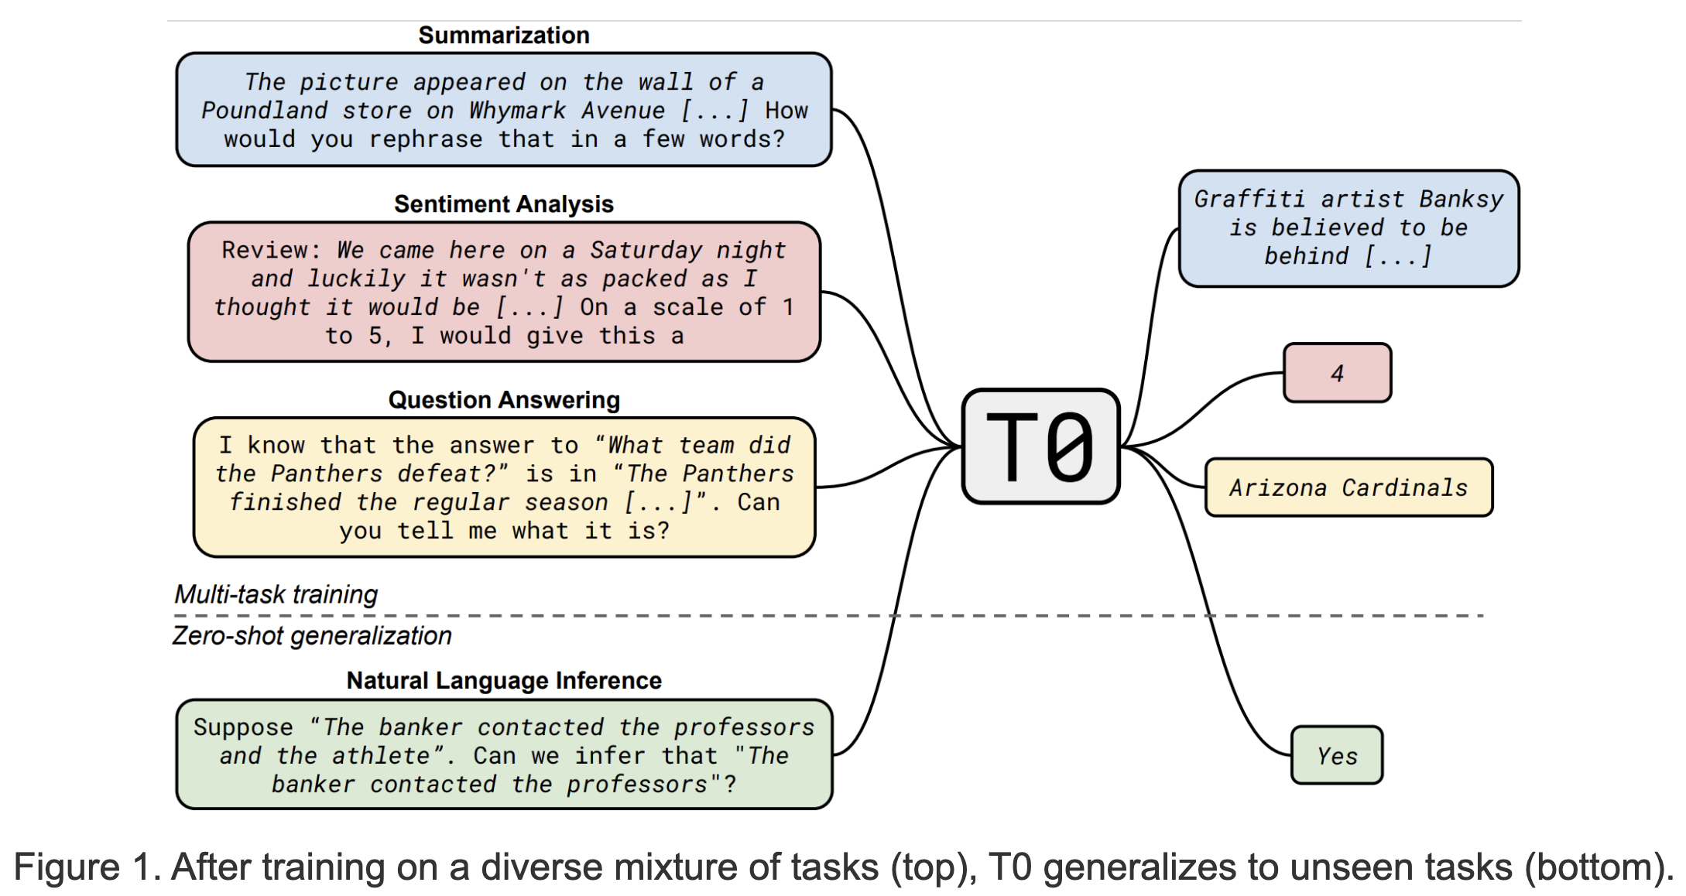
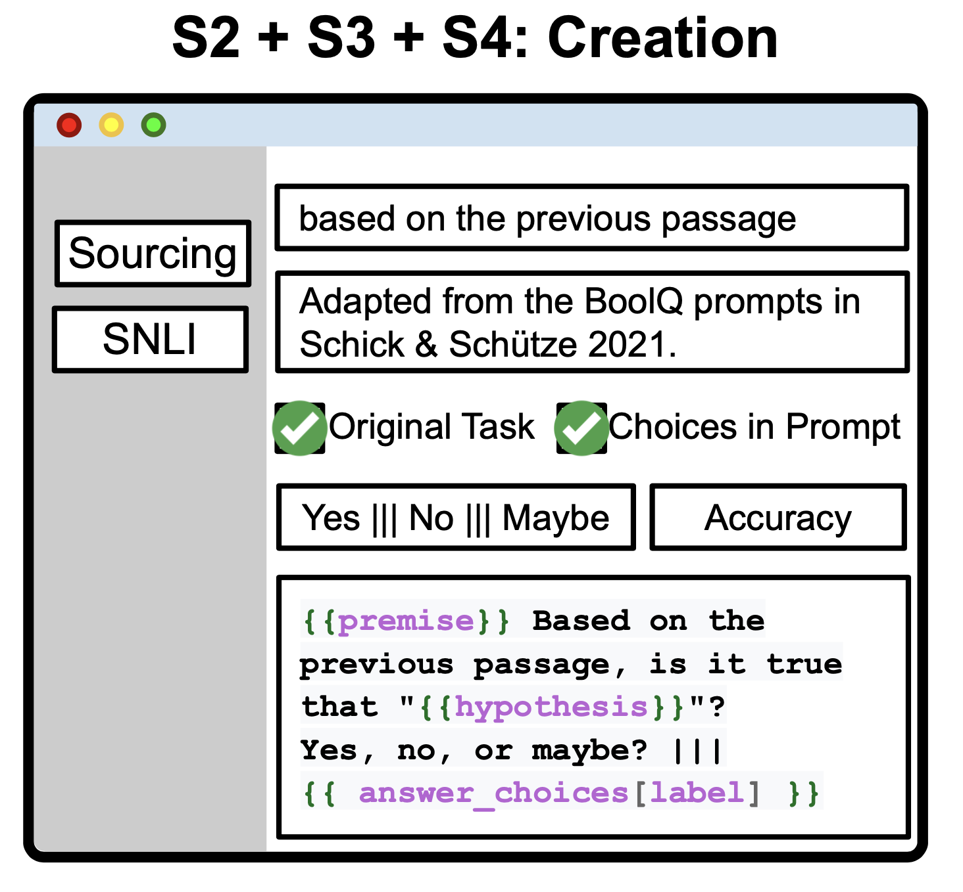
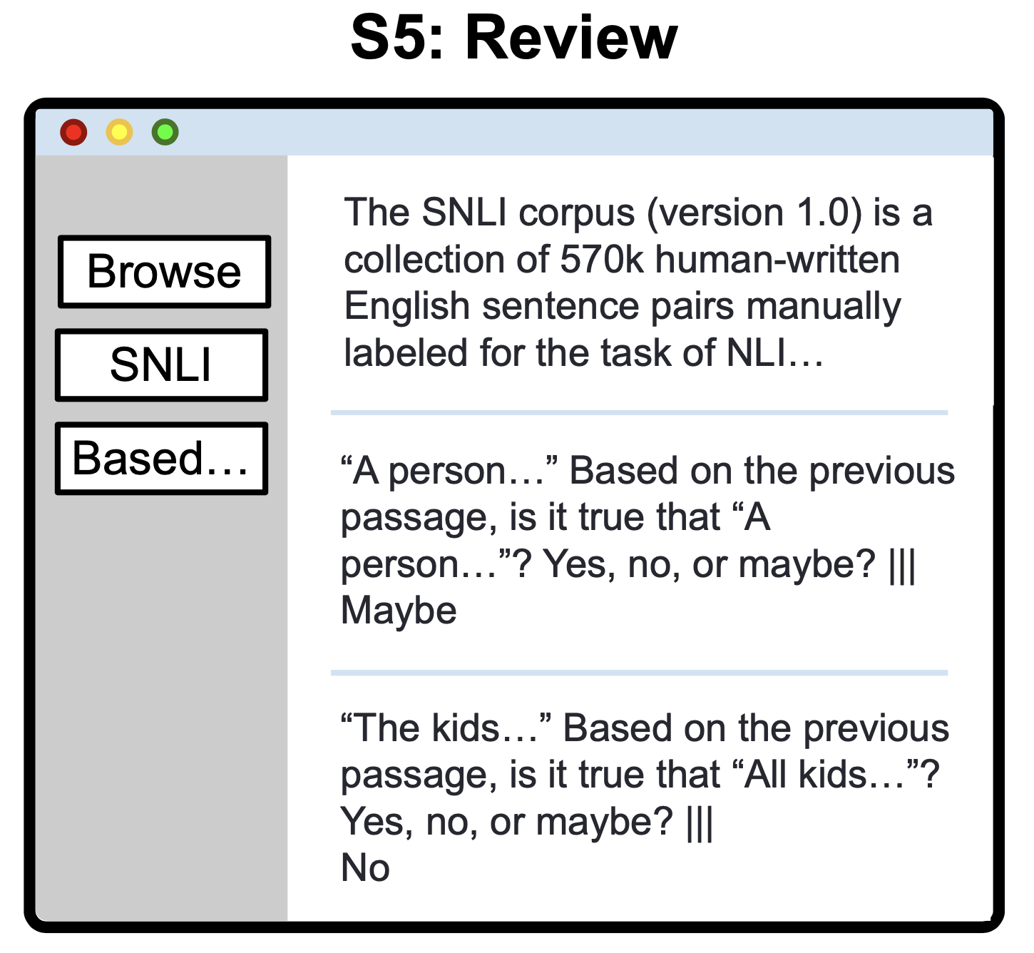
Context - T0 and PromptSource
Raffel, C. et al. Exploring the Limits of Transfer Learning with a Unified Text-to-Text Transformer. Journal of Machine Learning Research 21, 1–67 (2020).
Wei, J. et al. Finetuned Language Models are Zero-Shot Learners. in (2021).
Bach, S. H. et al. PromptSource: An Integrated Development Environment and Repository for Natural Language Prompts. arXiv:2202.01279 [cs] (2022).
Notes:
T0, T5 fine-tuned on “prompted” multi-task corpus
T0++, 11B parameters
Smallest model is 3B parameters
T5 is “scaled-up” version of original encoder-decoder transformer from 2017.
Beginning of casting everything as text
PromptSource: GitHub repo/framework based on “prompt templates” for porting existing tasks to prompt format.
T0 relies on inputs fitting into these prompt templates.

Slide 5
Requirements for evaluation
Hardware for 3B-param model (full-size is 11B)
Dutch and French Datasets
Templates for prompting in Dutch and French, for evaluation

Slide 6
Hardware requirements
We’ll come back to this :)

Slide 7
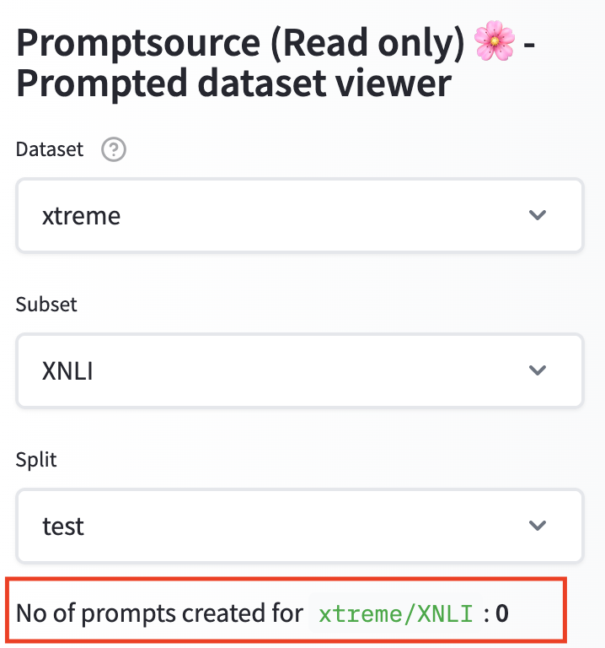
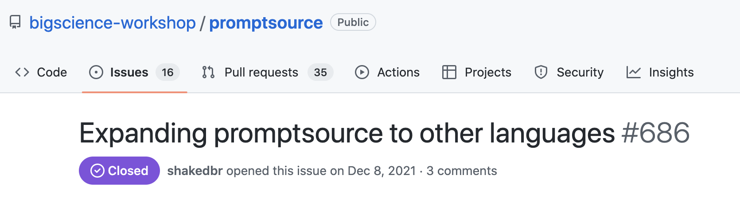
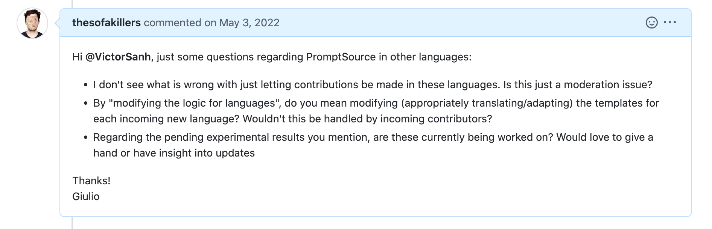
Data Requirements
Notes:
PromptSource only supported English!!!!!!!
Now they have allowed for support of other languages, but very little coverage.

Slide 8


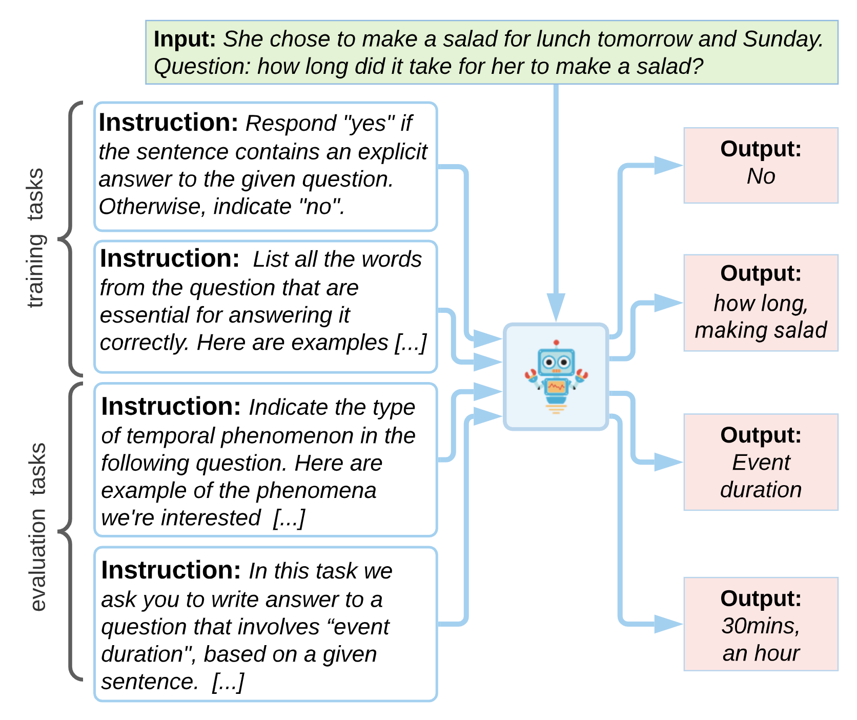
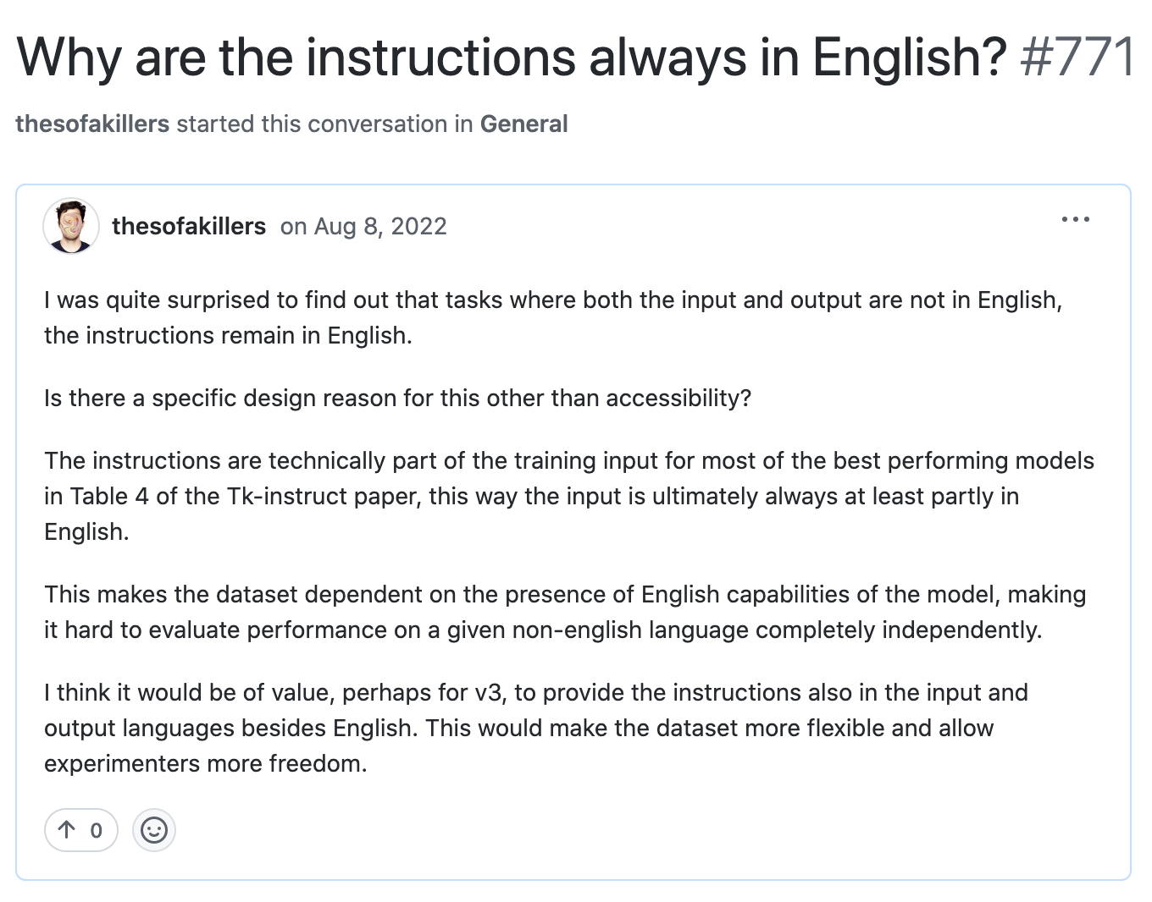
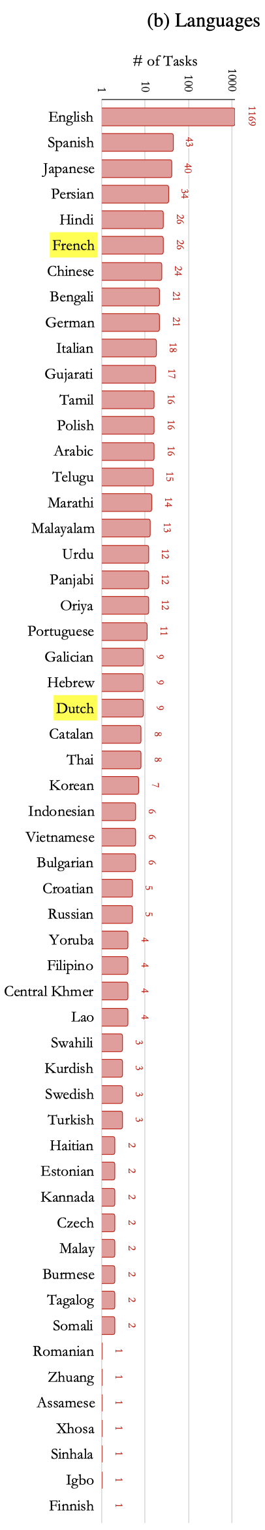
Data Requirements - Continued
Wang, Y. et al. Benchmarking Generalization via In-Context Instructions on 1,600+ Language Tasks. arXiv:2204.07705 [cs] (2022).
Notes:
Very similar work from Allen Institute for AI, also T5 base
”instructions” rather than “prompts”, but basically same thing
Unlike T0, also multilingual!
Problem: the instructions in the template are always in English!
Relies on the multilinguality of the base (they use mT5)

Slide 9
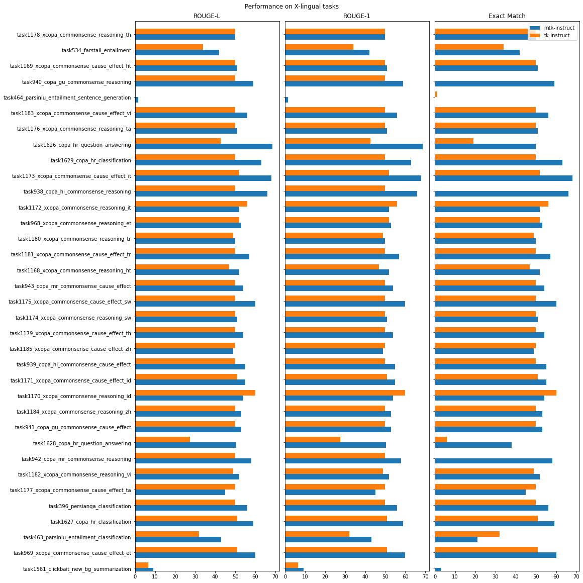
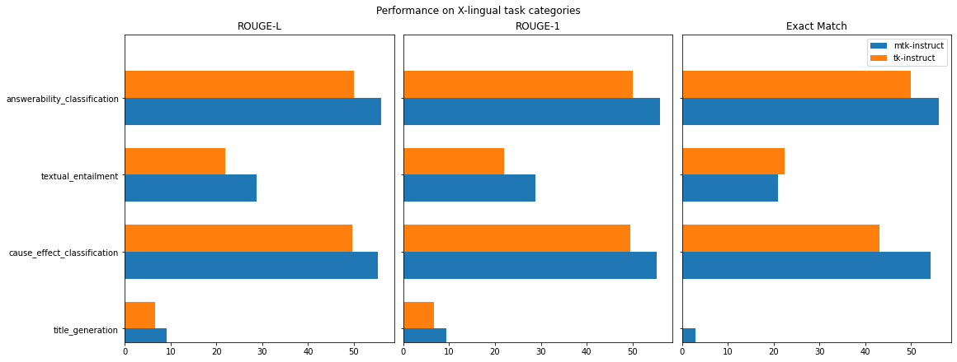

Brief Aside – Tk-instruct
Notes:
Brief aside
We perform evaluation to get de-structured values for each task and task category
(paper only reports averages or difference from baseline)

Slide 10
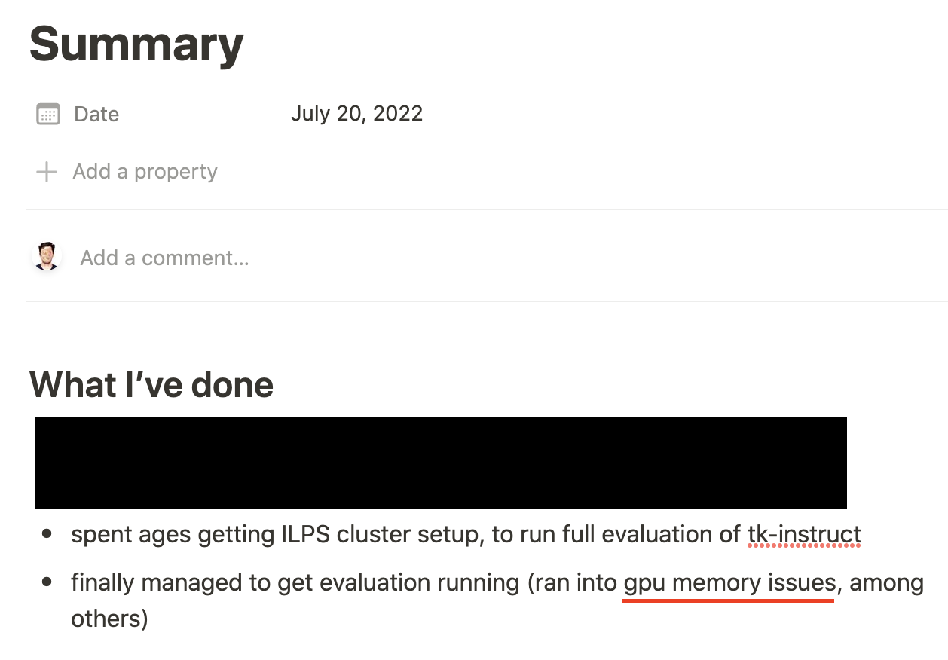
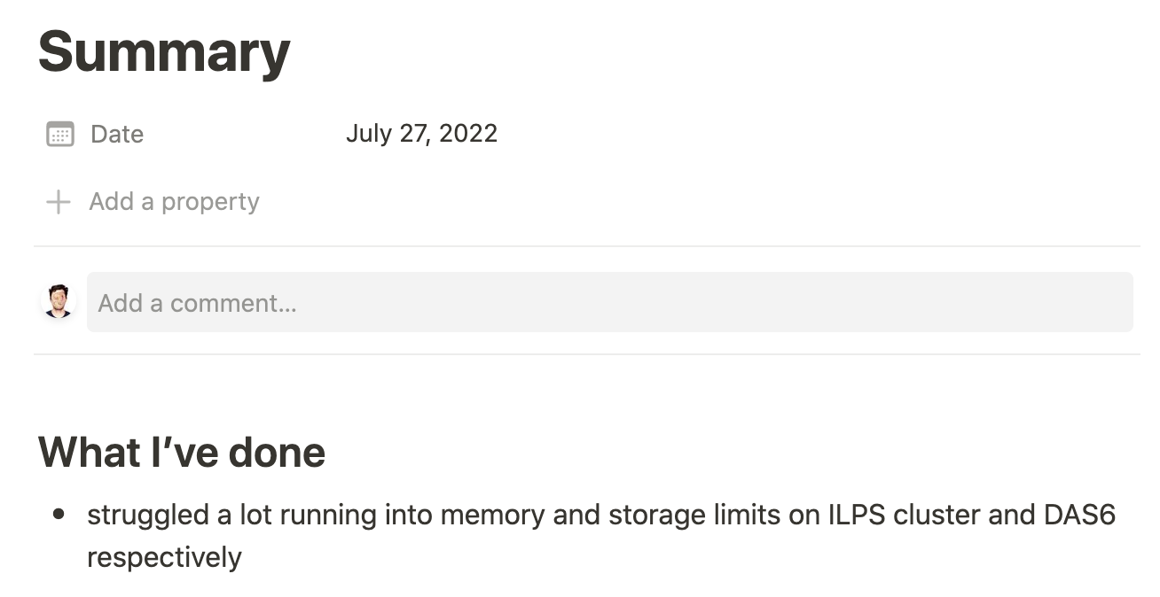
Hardware requirements
Notes:
Logs from work diary
Running into memory issues
Couldn’t really be fixed without truncating long inputs.

Slide 11
Problems
Models too big
No real prompt/instruction datasets outside of english
Notes:
Need prompts for evaluation

Slide 12
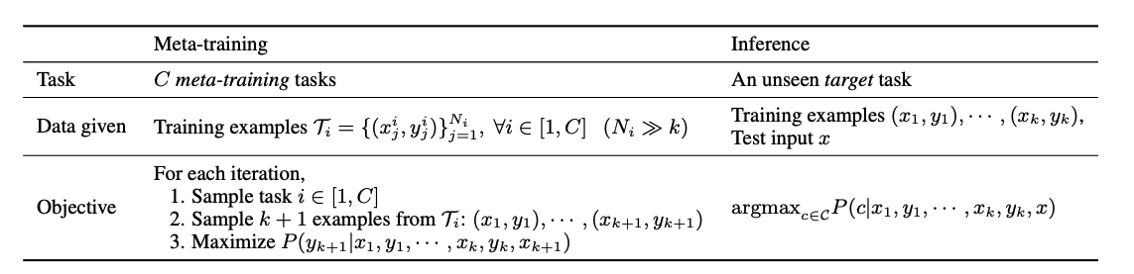
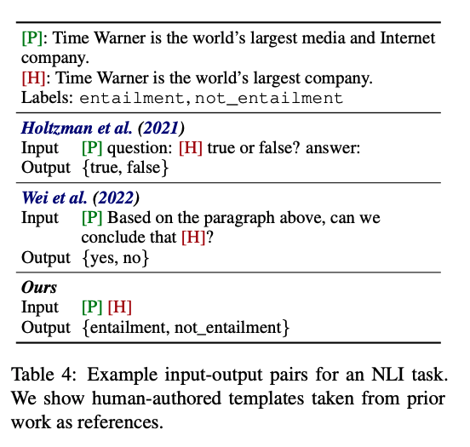
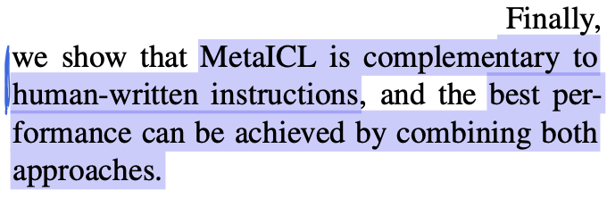
Solution - MetaICL: Learning to Learn In Context
Hardware requirements:
Max model size: 774M params (GPT2-large)
Dataset requirements:
No need for instructions/prompt templates
input/output pairs simply concatenated
Task requirements:
Multi-task generalisation via in-context learning (ICL)
Compatible with Instructions/Prompts
Min, S., Lewis, M., Zettlemoyer, L. & Hajishirzi, H. MetaICL: Learning to Learn In Context. in Proceedings of the 2022 Conference of the North American Chapter of the Association for Computational Linguistics: Human Language Technologies 2791–2809 (Association for Computational Linguistics, 2022). doi:10.18653/v1/2022.naacl-main.201.
Notes:
Talk about how metaICL works, TOP and right
Talk about the checkmarks

Slide 13
Next Step
Find downstream tasks in French and Dutch for evaluation

Slide 14
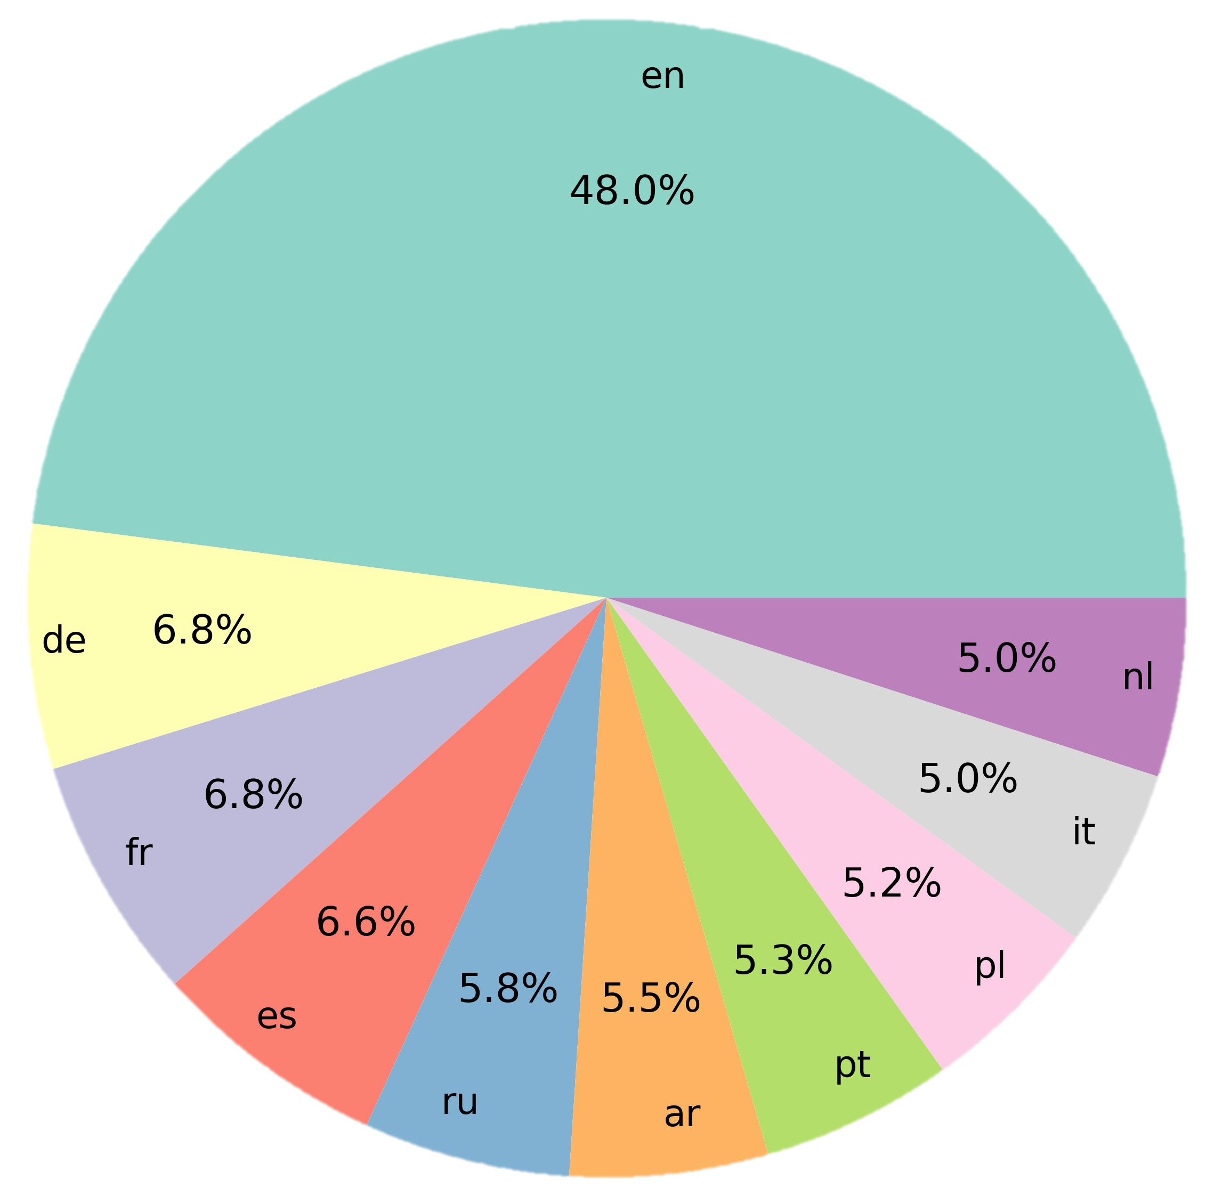
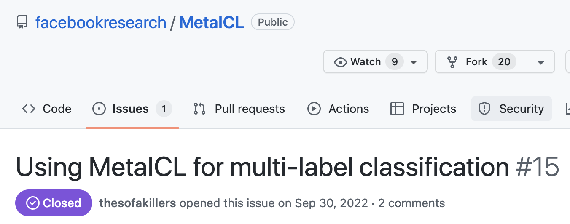
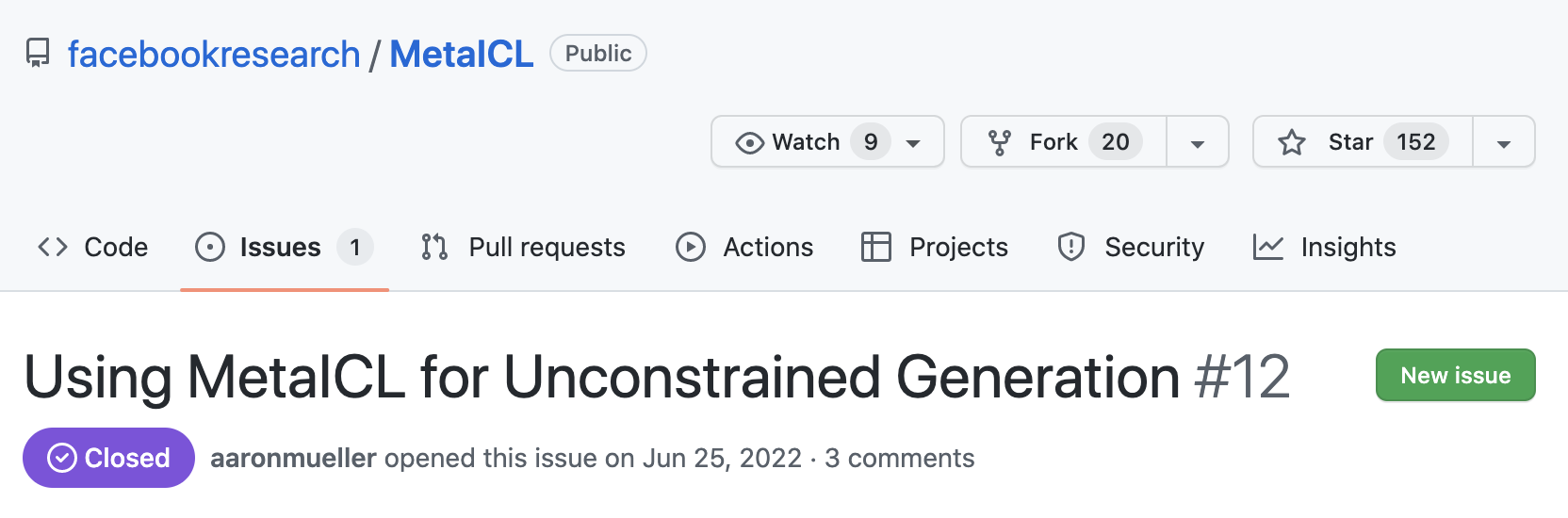
More Dataset considerations
MetaICL can only handle multi-class, single-label tasks.
Want to use datasets that exist across all three of languages
Enable fairer comparison in language dimension
Notes:
Percentage of monolingual datasets for the top 10 most common languages on huggingface

Slide 15
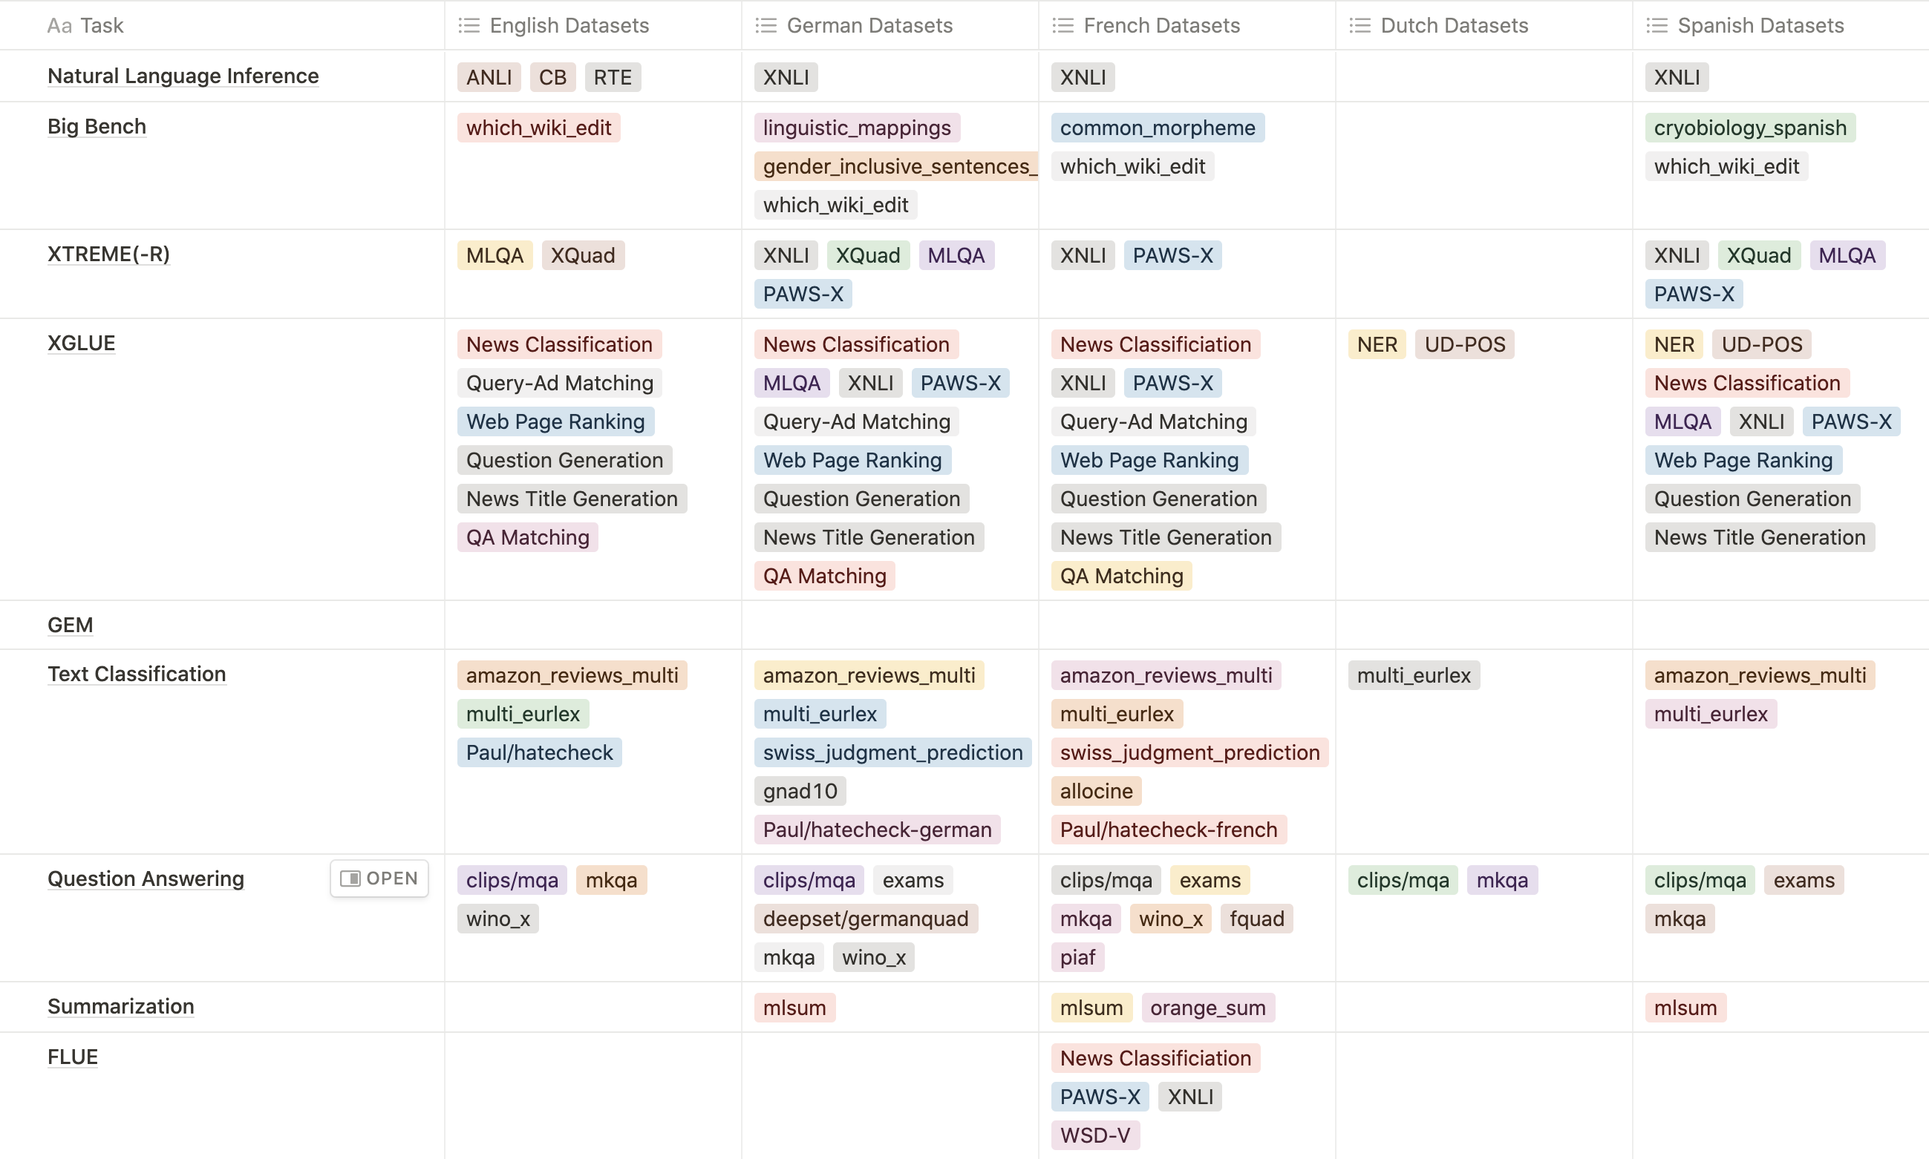
More Dataset considerations
French and German
lack of Dutch datasets
Notes:
This is me searching for datasets on HF
Decided to abandon Dutch, see empty column. Change to German

Slide 16
Recap
Using MetaICL (774M params) instead of T0 or Tk-instruct (11B params)
Adapting to French and German instead of French and Dutch
Ok, this is the setup – how are we actually going to tackle the adaptation task?

Slide 17
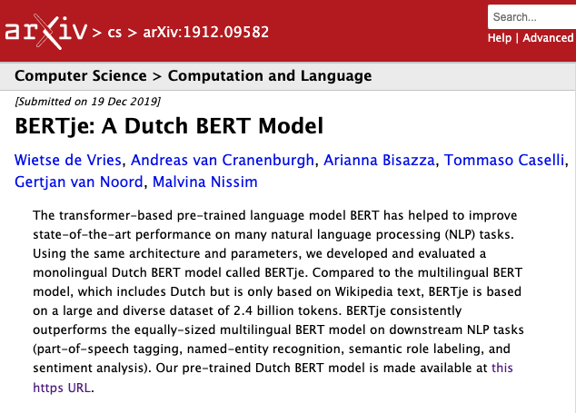
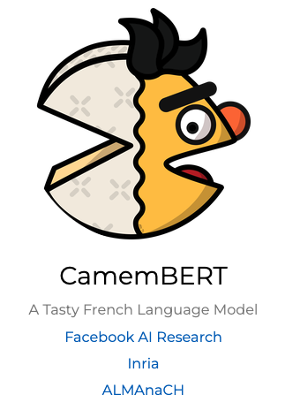
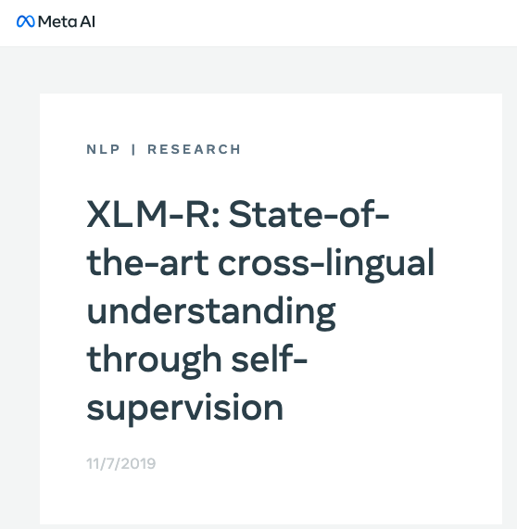
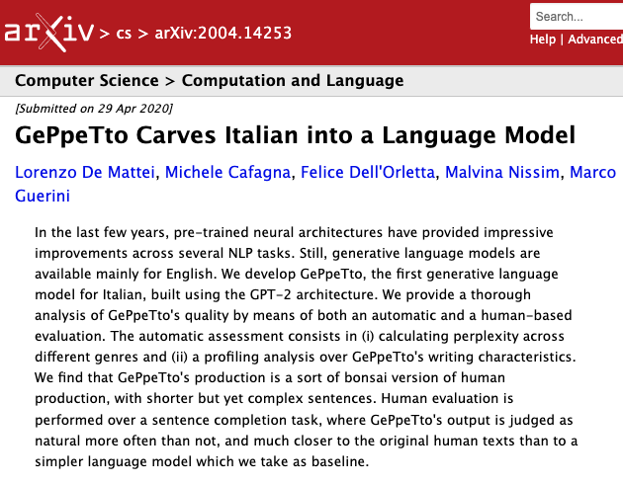
Multilingual and non-English NLP
Notes:
Multilingual NLP
Mainly restricted to pretraining and encoder-only architectures for downstream tasks
Curse of multilinguality: performance on low resource languages degrades as you add more languages
Monolingual models:
Infeasible to train a new model for every language.

Slide 18
Problems
Multilingual Models
Curse of multilinguality
Not really what we’re tackling
Non-english trained from scratch
Unfeasible to train a new BERT/GPT for every language
More esoteric datasets only in English

Slide 19
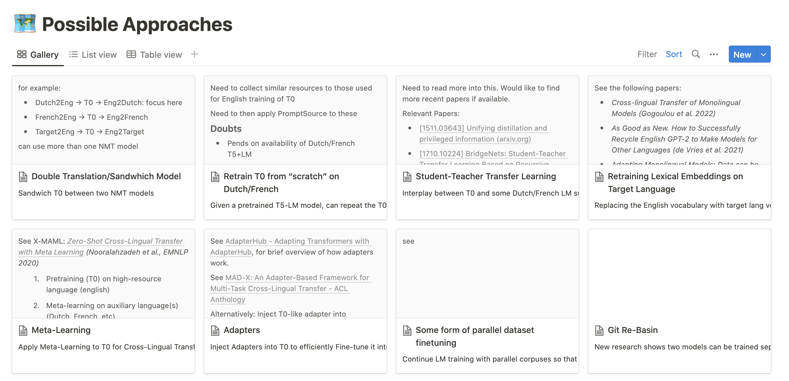
Notes:
quick: considered a number of approaches

Slide 20
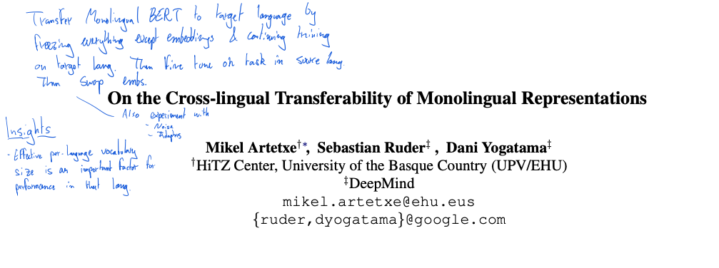
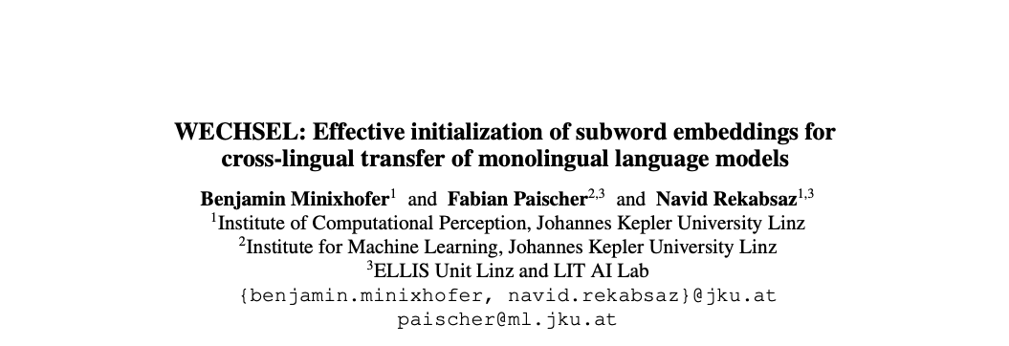
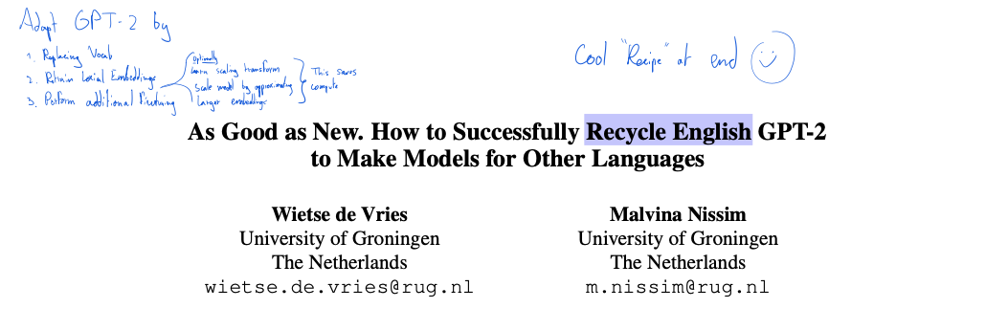
Cross-Lingual Adaptation of Monolingual Language Models
Notes:
What’s the literature doing?
Replace tokenizer with one trained on target language
Re-initialize and retrain lexical embeddings in target language
WECHSEL: re-initialization is done “smartly” by leveraging parallel static word embeddings
Result: re-initialized embeddings are in similar sematnic space
Evaluation limits itself to intrinsic (PPL) for decoder-only (GPT2) models
Evaluation is only on small GPT2 variant

Slide 21
Questions
What if we evaluate adapted GPT2 models extrinsically?
Does this scale with larger GPT2 sizes?
Can this be directly applied to Fine-Tuned models, preserving Fine-tuning?
Notes:
Preserving fine-tuning: WECHSEL retrains entire model on target language after initialization, so maybe this will cause catastrophic forgetting

Slide 22
Our work
considers techniques for the efficient cross-lingual transfer of monolingual models fine-tuned on in-context learning (ICL).
Contributions
Show that WECHSEL scales to large GPT2 variant. We release German and French GPT2-large checkpoints.
Evaluate geWECHSELt models extrinsically on downstream tasks
Assess whether WECHSEL can be applied to fine-tuned models without causing catastrophic forgetting
Introduce the notion of “targeted distillation”, a form of post-hoc disentanglement leveraging vessel adapters. “PHoDiVA”
Notes:
PHoDiVA
Post Hoc Disentanglement via Vessel Adapters

Slide 23

Method
“PHoDiVA”
N. Houlsby et al., ‘Parameter-Efficient Transfer Learning for NLP’, in Proceedings of the 36th International Conference on Machine Learning, May 2019, pp. 2790–2799. [Online]. Available: https://proceedings.mlr.press/v97/houlsby19a.html
Notes:
Talk about Adapters
introduce a small amount of new parameters and only update these while keeping the pre-trained model weights fixed
Enable modularity
Then talk through models one-by-one

Slide 24
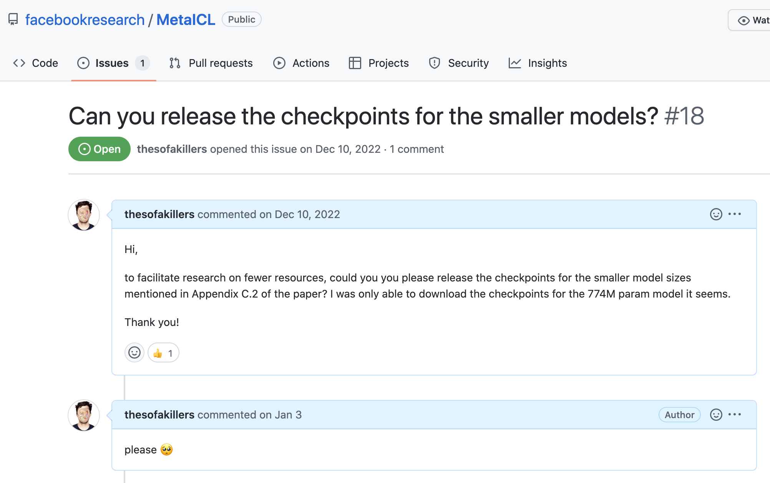
Experimental Setup
Notes:
Need to work with GPT2-large because smaller variants of MetaICL not shared.

Slide 25
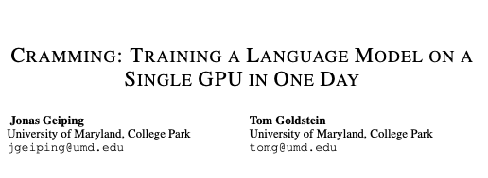
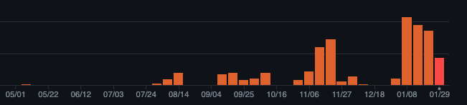
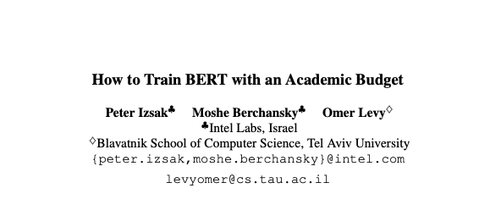
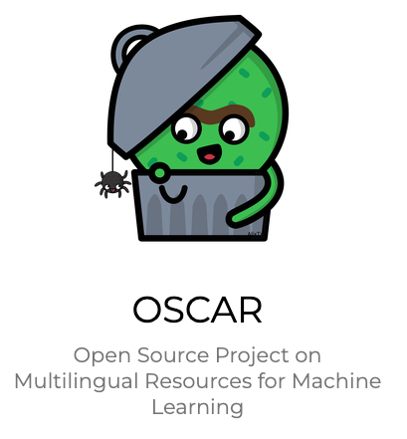
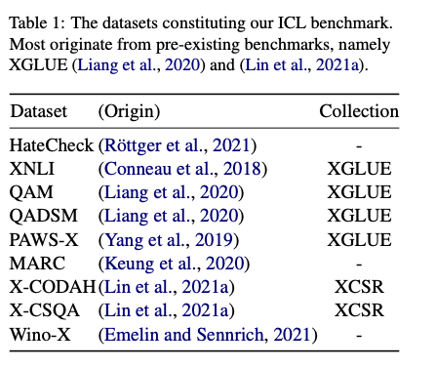
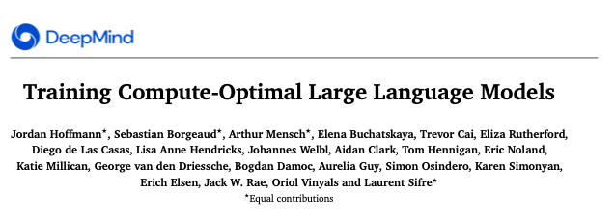
Experimental Setup
Notes:
Crammed everything, papers on the right to squeeze the most I could. Limited myself to 24 hrs per run to avoid running out of SBUs

Slide 26
Results and Analysis
WECHSEL scales to larger models in terms of intrinsic evaluation
future work: check if this holds for converged models

Slide 27
Results and Analysis

Slide 28
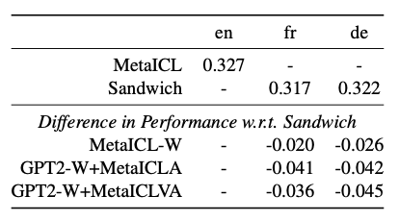
Results and Analysis
Sandwich performs roughly on par with MetaICL!
Fail to reproduce MetaICL performance from original paper
Proposed models underperform compared to Sandwich
Notes:
sandwich and metaICL performance
- Translation API very good?
- Our Benchmark more difficult than original?

Slide 29
Limitations
Preliminary nature
Needed Larger compute scale, more use of DeepSpeed and other Eng. advancements
Hyperparameter sweeps
More in depth look at available Adapters necessary
More in depth look at PHoDiVA
Small-ish multi-task framework
Relies on translations, which can suffer from noise
Remains monolingual. Can we adapt a monolingual model to a new language and maintain the original language?
All the limitations of MetaICL are preserved
Only one seed tested ☹
Notes:
Limitations of MetaICL:
Only works with single-label classification
16 shots occupy space in context
only examines decoder-only transformers

Slide 30
Conclusion and Lessons Learned
WECHSEL scales to larger model sizes
But all our attempts at adapting fine-tuned ICL-capable models underperform compared to our Sandwich baseline.
Non-English NLP datasets are severely lacking.
Don’t over-read, start experimenting ASAP.
Engineering gets in the way
Think about evaluation early-on.
Try to think about the resources required early on.
“Small” models are bigger than you think

Slide 31
Thank you!

Slide 32
References
[15]
B. Y. Lin, S. Lee, X. Qiao, and X. Ren, ‘Common Sense Beyond English: Evaluating and Improving Multilingual Language Models for Commonsense Reasoning’, in Proceedings of the 59th Annual Meeting of the Association for Computational Linguistics and the 11th International Joint Conference on Natural Language Processing (Volume 1: Long Papers), Online, Aug. 2021, pp. 1274–1287. doi: 10.18653/v1/2021.acl-long.102.
[16]
W. de Vries and M. Nissim, ‘As Good as New. How to Successfully Recycle English GPT-2 to Make Models for Other Languages’, in Findings of the Association for Computational Linguistics: ACL-IJCNLP 2021, Online, Aug. 2021, pp. 836–846. doi: 10.18653/v1/2021.findings-acl.74.
[17]
W. de Vries, M. Bartelds, M. Nissim, and M. Wieling, ‘Adapting Monolingual Models: Data can be Scarce when Language Similarity is High’, in Findings of the Association for Computational Linguistics: ACL-IJCNLP 2021, Online, Aug. 2021, pp. 4901–4907. doi: 10.18653/v1/2021.findings-acl.433.
[18]
B. Chan, S. Schweter, and T. Möller, ‘German’s Next Language Model’, in Proceedings of the 28th International Conference on Computational Linguistics, Barcelona, Spain (Online), Dec. 2020, pp. 6788–6796. doi: 10.18653/v1/2020.coling-main.598.
[19]
Y. Liang et al., ‘XGLUE: A New Benchmark Datasetfor Cross-lingual Pre-training, Understanding and Generation’, in Proceedings of the 2020 Conference on Empirical Methods in Natural Language Processing (EMNLP), Online, Nov. 2020, pp. 6008–6018. doi: 10.18653/v1/2020.emnlp-main.484.
[20]
P. Keung, Y. Lu, G. Szarvas, and N. A. Smith, ‘The Multilingual Amazon Reviews Corpus’, in Proceedings of the 2020 Conference on Empirical Methods in Natural Language Processing (EMNLP), Online, Nov. 2020, pp. 4563–4568. doi: 10.18653/v1/2020.emnlp-main.369.
[21]
P. J. Ortiz Suárez, L. Romary, and B. Sagot, ‘A Monolingual Approach to Contextualized Word Embeddings for Mid-Resource Languages’, in Proceedings of the 58th Annual Meeting of the Association for Computational Linguistics, Online, Jul. 2020, pp. 1703–1714. doi: 10.18653/v1/2020.acl-main.156.
[22]
L. Martin et al., ‘CamemBERT: a Tasty French Language Model’, in Proceedings of the 58th Annual Meeting of the Association for Computational Linguistics, Online, Jul. 2020, pp. 7203–7219. doi: 10.18653/v1/2020.acl-main.645.
[23]
L. De Mattei, M. Cafagna, F. Dell’Orletta, M. Nissim, and M. Guerini, ‘GePpeTto Carves Italian into a Language Model’. arXiv, Apr. 29, 2020. doi: 10.48550/arXiv.2004.14253.
[24]
A. Conneau et al., ‘Unsupervised Cross-lingual Representation Learning at Scale’, arXiv:1911.02116 [cs], Apr. 2020, Accessed: Feb. 10, 2022. [Online]. Available: http://arxiv.org/abs/1911.02116
[25]
W. de Vries, A. van Cranenburgh, A. Bisazza, T. Caselli, G. van Noord, and M. Nissim, ‘BERTje: A Dutch BERT Model’. arXiv, Dec. 19, 2019. doi: 10.48550/arXiv.1912.09582.
[26]
Y. Yang, Y. Zhang, C. Tar, and J. Baldridge, ‘PAWS-X: A Cross-lingual Adversarial Dataset for Paraphrase Identification’, in Proceedings of the 2019 Conference on Empirical Methods in Natural Language Processing and the 9th International Joint Conference on Natural Language Processing (EMNLP-IJCNLP), Hong Kong, China, Nov. 2019, pp. 3687–3692. doi: 10.18653/v1/D19-1382.
[27]
N. Houlsby et al., ‘Parameter-Efficient Transfer Learning for NLP’, in Proceedings of the 36th International Conference on Machine Learning, May 2019, pp. 2790–2799. Accessed: Feb. 13, 2023. [Online]. Available: https://proceedings.mlr.press/v97/houlsby19a.html
[28]
A. Conneau et al., ‘XNLI: Evaluating Cross-lingual Sentence Representations’, arXiv:1809.05053 [cs], Sep. 2018, Accessed: Feb. 10, 2022. [Online]. Available: http://arxiv.org/abs/1809.05053
[1]
J. Geiping and T. Goldstein, ‘Cramming: Training a Language Model on a Single GPU in One Day’. arXiv, Dec. 28, 2022. doi: 10.48550/arXiv.2212.14034.
[2]
BigScience Workshop, ‘BLOOM: A 176B-Parameter Open-Access Multilingual Language Model’. arXiv, Dec. 10, 2022. doi: 10.48550/arXiv.2211.05100.
[3]
H. W. Chung et al., ‘Scaling Instruction-Finetuned Language Models’. arXiv, Dec. 06, 2022. doi: 10.48550/arXiv.2210.11416.
[4]
B. Minixhofer, F. Paischer, and N. Rekabsaz, ‘WECHSEL: Effective initialization of subword embeddings for cross-lingual transfer of monolingual language models’, in Proceedings of the 2022 Conference of the North American Chapter of the Association for Computational Linguistics: Human Language Technologies, Seattle, United States, Jul. 2022, pp. 3992–4006. doi: 10.18653/v1/2022.naacl-main.293.
[5]
S. Min, M. Lewis, L. Zettlemoyer, and H. Hajishirzi, ‘MetaICL: Learning to Learn In Context’, in Proceedings of the 2022 Conference of the North American Chapter of the Association for Computational Linguistics: Human Language Technologies, Seattle, United States, Jul. 2022, pp. 2791–2809. doi: 10.18653/v1/2022.naacl-main.201.
[6]
E. Gogoulou, A. Ekgren, T. Isbister, and M. Sahlgren, ‘Cross-lingual Transfer of Monolingual Models’, in Proceedings of the Thirteenth Language Resources and Evaluation Conference, Marseille, France, Jun. 2022, pp. 948–955. Accessed: Feb. 02, 2023. [Online]. Available: https://aclanthology.org/2022.lrec-1.100
[7]
J. Hoffmann et al., ‘Training Compute-Optimal Large Language Models’. arXiv, Mar. 29, 2022. doi: 10.48550/arXiv.2203.15556.
[8]
S. H. Bach et al., ‘PromptSource: An Integrated Development Environment and Repository for Natural Language Prompts’, arXiv:2202.01279 [cs], Mar. 2022, Accessed: Apr. 07, 2022. [Online]. Available: http://arxiv.org/abs/2202.01279
[9]
L. Ouyang et al., ‘Training language models to follow instructions with human feedback’. arXiv, Mar. 04, 2022. doi: 10.48550/arXiv.2203.02155.
[10]
Q. Lhoest et al., ‘Datasets: A Community Library for Natural Language Processing’, in Proceedings of the 2021 Conference on Empirical Methods in Natural Language Processing: System Demonstrations, Online and Punta Cana, Dominican Republic, Nov. 2021, pp. 175–184. doi: 10.18653/v1/2021.emnlp-demo.21.
[11]
D. Emelin and R. Sennrich, ‘Wino-X: Multilingual Winograd Schemas for Commonsense Reasoning and Coreference Resolution’, in Proceedings of the 2021 Conference on Empirical Methods in Natural Language Processing, Online and Punta Cana, Dominican Republic, Nov. 2021, pp. 8517–8532. doi: 10.18653/v1/2021.emnlp-main.670.
[12]
J. Wei et al., ‘Finetuned Language Models are Zero-Shot Learners’, presented at the International Conference on Learning Representations, Sep. 2021. Accessed: Apr. 07, 2022. [Online]. Available: https://openreview.net/forum?id=gEZrGCozdqR
[13]
P. Izsak, M. Berchansky, and O. Levy, ‘How to Train BERT with an Academic Budget’. arXiv, Sep. 09, 2021. doi: 10.48550/arXiv.2104.07705.
[14]
P. Röttger, B. Vidgen, D. Nguyen, Z. Waseem, H. Margetts, and J. Pierrehumbert, ‘HateCheck: Functional Tests for Hate Speech Detection Models’, in Proceedings of the 59th Annual Meeting of the Association for Computational Linguistics and the 11th International Joint Conference on Natural Language Processing (Volume 1: Long Papers), Online, Aug. 2021, pp. 41–58. doi: 10.18653/v1/2021.acl-long.4.

